Slide 1
Distribution of Sampling Statistics
Mr. Sunanda Das, Assistant Professor, Dept. of CSE, KUET

Slide 2
Populations, Samples, Parameters, and Statistics
The field of inferential statistics enables us to make educated guesses about the numerical characteristics of large groups.
The logic of sampling gives us a way to test conclusions about such groups using only a small portion of its members.
A population includes all of the elements from a set of data.
A sample consists one or more observations drawn from the population.

Slide 3
Sampling
sampling method is a procedure for selecting sample elements from a population. Simple random sampling refers to a sampling method that has the following properties.
The population consists of N objects.
The sample consists of n objects.
All possible samples of n objects are equally likely to occur.

Slide 4
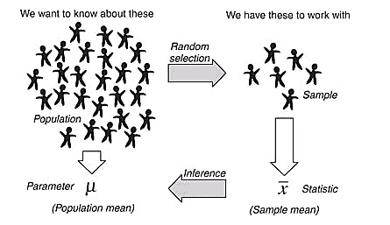
A parameter is a characteristic of a population. A statistic is a characteristic of a sample.

Slide 5
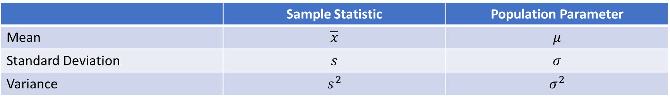
 | Sample Statistic | Population Parameter
Mean | $$\overline{x}$$ | $$μ$$
Standard Deviation | $$s$$ | $$σ$$
Variance | $$s^{2}$$ | $$σ^{2}$$

Slide 6
Standard Deviation and Variance
Standard deviation measures how spread out the values in a data set are around the mean.
Variance is the average of the squared differences from the Mean.

Slide 7
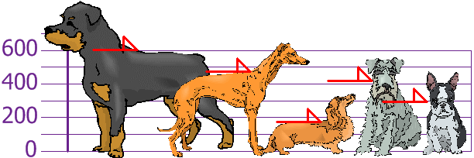
You and your friends have just measured the heights of your dogs (in millimeters):
The heights (at the shoulders) are: 600mm, 470mm, 170mm, 430mm and 300mm.

Slide 8
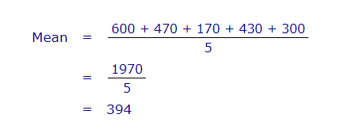
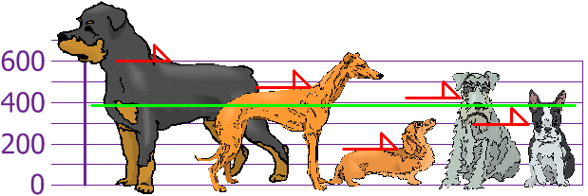

Slide 9
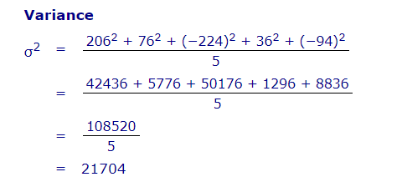
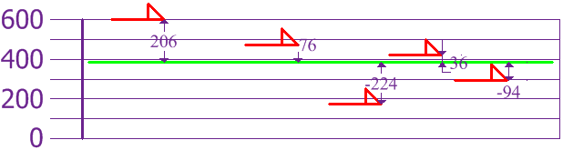

Slide 10
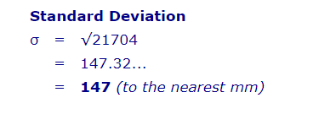
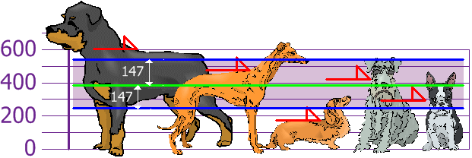

Slide 11
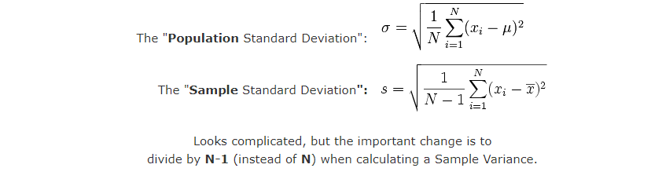

Slide 12
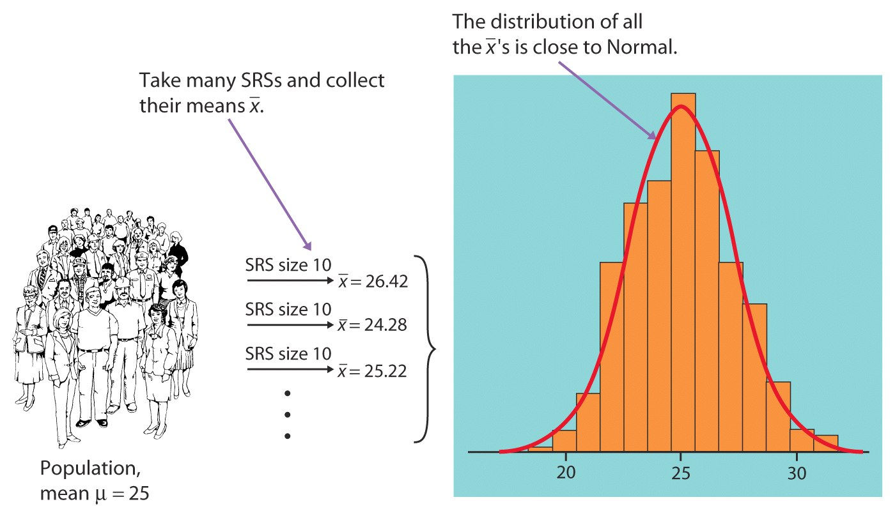
SRS: simple random sample

Slide 13
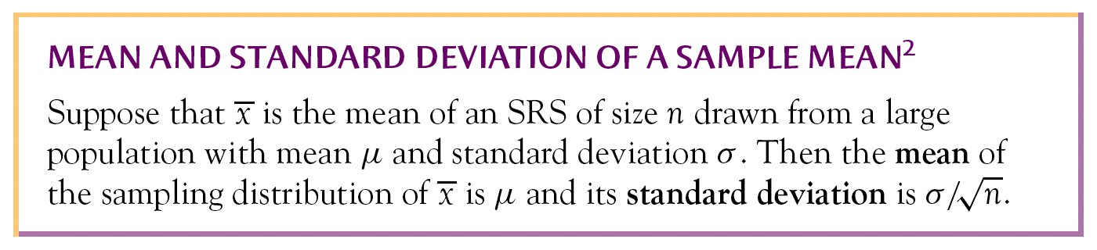
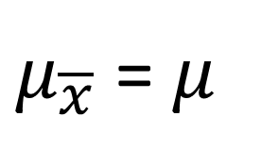
Central Limit Theorem
$μ_{\overline{x}}$ = $μ$

Slide 14
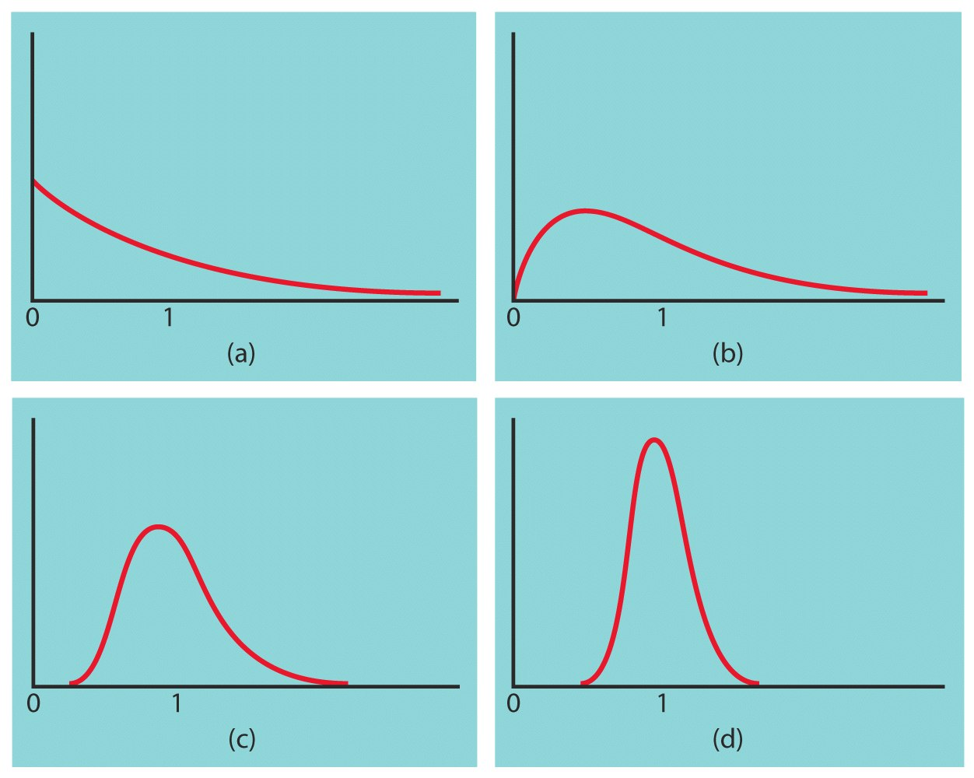
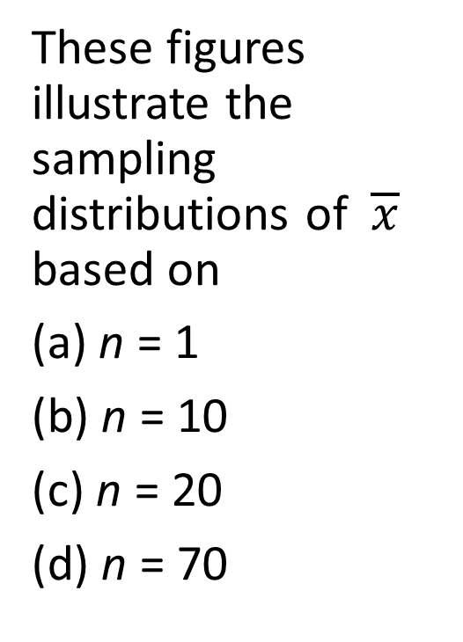
Central Limit Theorem
These figures illustrate the sampling distributions of $\overline{x}$ based on
n = 1
n = 10
n = 20
n = 70

Slide 15
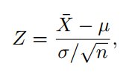
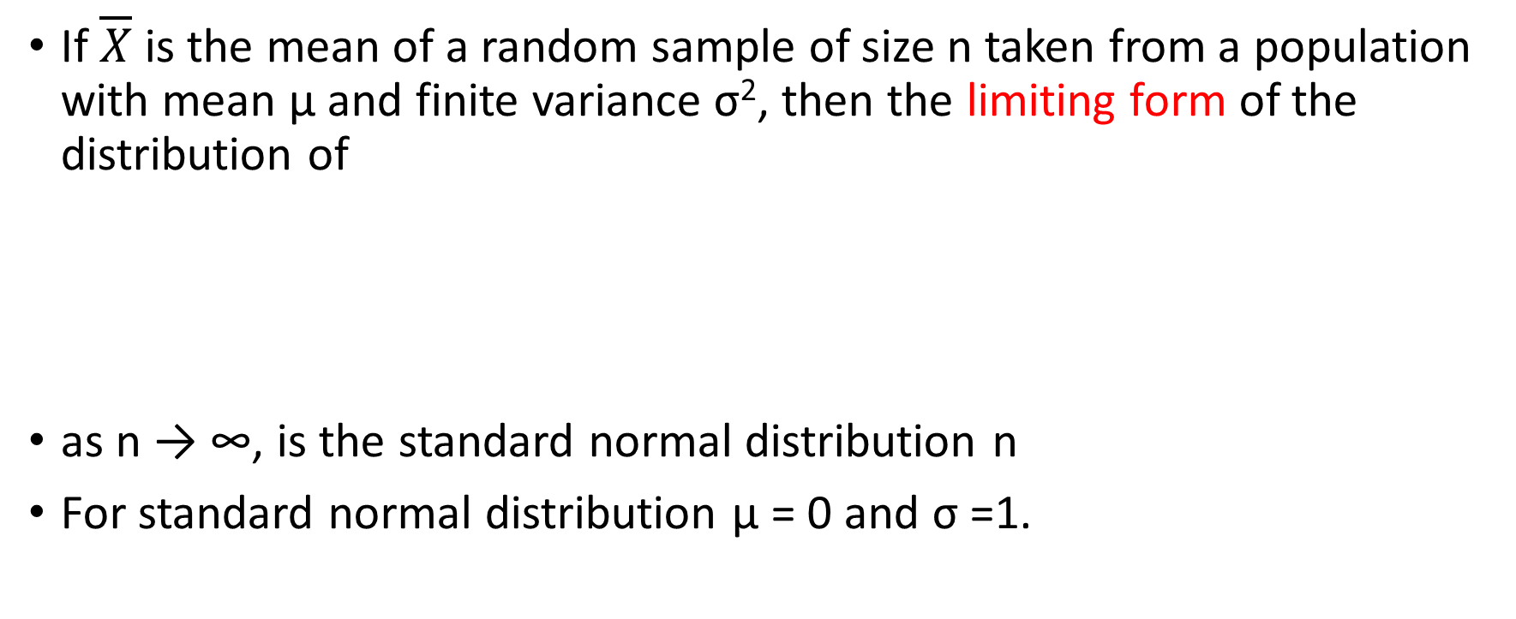
Central limit theorem
If $\overline{X}$ is the mean of a random sample of size n taken from a population with mean μ and finite variance σ², then the limiting form of the distribution of
as n → ∞, is the standard normal distribution n
For standard normal distribution μ = 0 and σ =1.

Slide 16
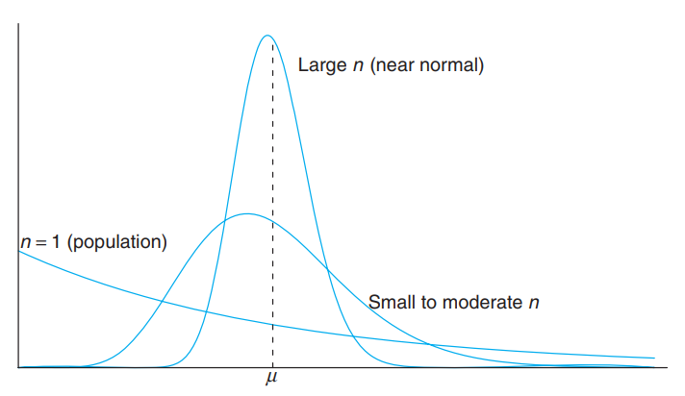
(distribution of $\overline{X}$ for n = 1, moderate n, and large n).

Slide 17
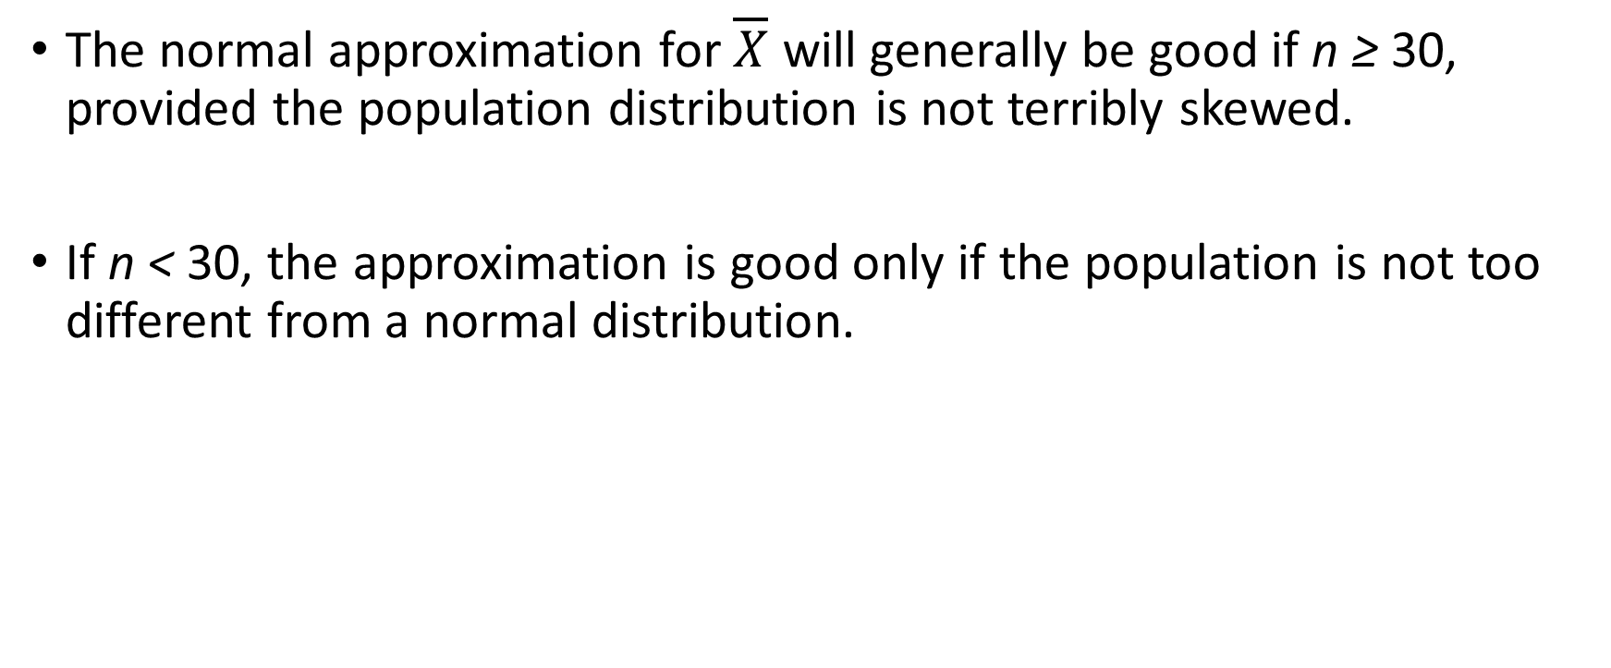
The normal approximation for $\overline{X}$ will generally be good if n ≥ 30, provided the population distribution is not terribly skewed.
If n < 30, the approximation is good only if the population is not too different from a normal distribution.

Slide 18
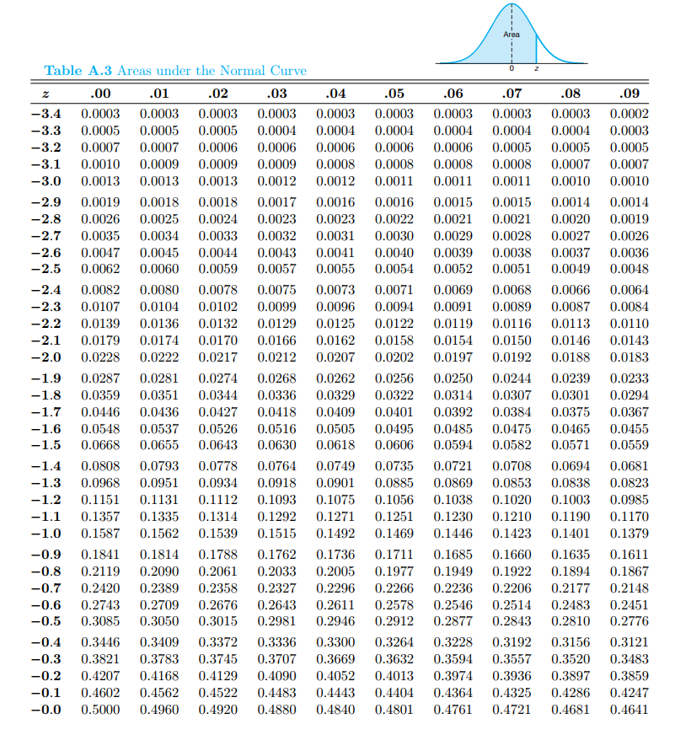
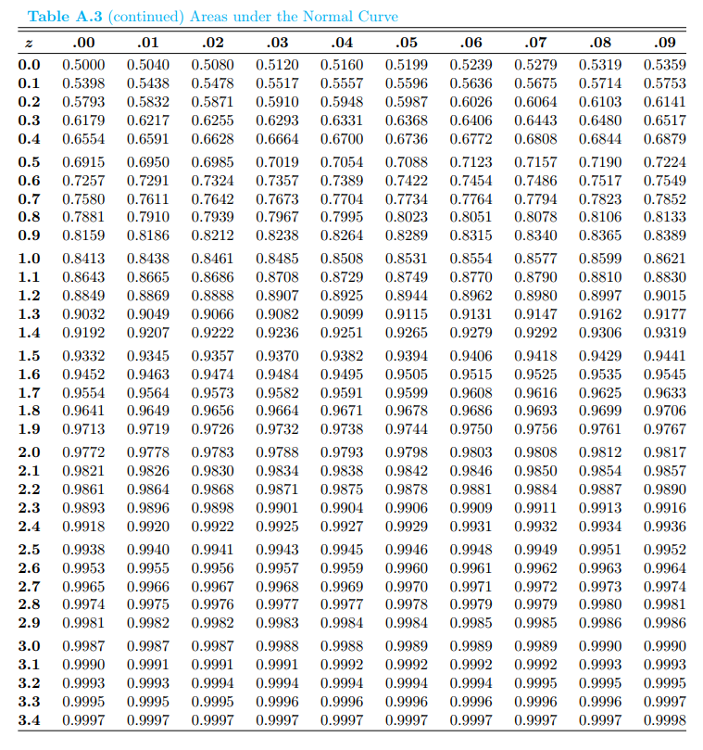

Slide 19
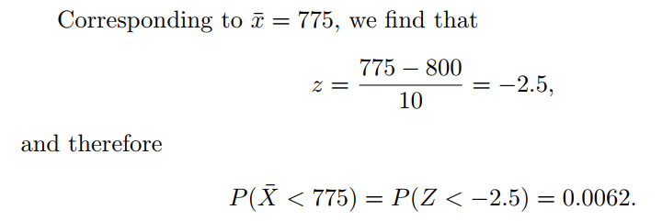
An electrical firm manufactures light bulbs that have a length of life that is approximately normally distributed, with mean equal to 800 hours and a standard deviation of 40 hours. Find the probability that a random sample of 16 bulbs will have an average life of less than 775 hours.

Slide 20
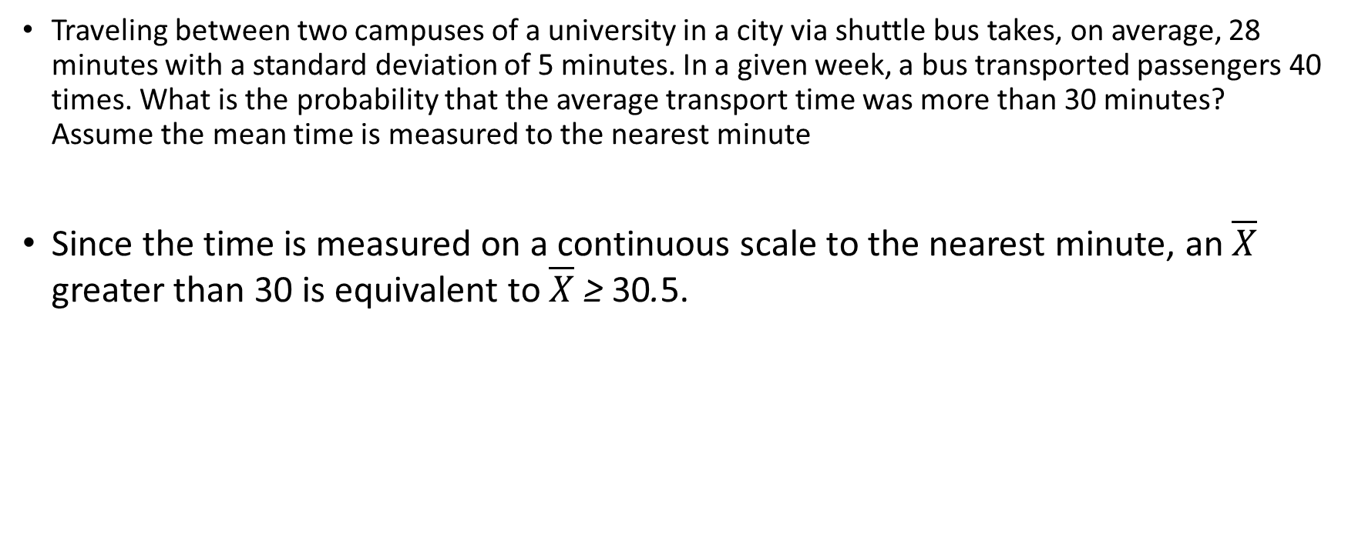
Traveling between two campuses of a university in a city via shuttle bus takes, on average, 28 minutes with a standard deviation of 5 minutes. In a given week, a bus transported passengers 40 times. What is the probability that the average transport time was more than 30 minutes? Assume the mean time is measured to the nearest minute
Since the time is measured on a continuous scale to the nearest minute, an $\overline{X}$ greater than 30 is equivalent to $\overline{X}$ ≥ 30.5.

Slide 21
Random Variable
In an experiment of chance, outcomes occur randomly. We often summarize the outcome from a random experiment by a simple number.
Random Variable
A function that assigns a real number to each outcome in the sample space of a random experiment.
We shall use a capital letter, say X, to denote a random variable and its corresponding small letter, x in this case, for one of its values.

Slide 22
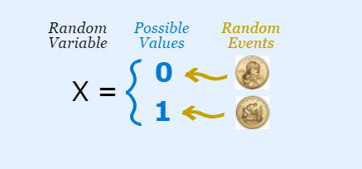
Random Variable
a variable whose values depend on outcomes of a random phenomenon.
X = {0, 1}
We have an experiment (such as tossing a coin)
We give values to each event
The set of values is a Random Variable

Slide 23
A balanced coin is tossed two times. List the elements of the sample space, the corresponding probabilities and the corresponding values x, where x is the number of getting head.
Random variable, X: the number of getting head.
Sample Space | Probability | x
HH | 1/4 | 2
HT | 1/4 | 1
TH | 1/4 | 1
TT | 1/4 | 0

Slide 24
Random Variable
2 types
Discrete Random Variables
A discrete random variable is one which may take on only a countable number of distinct values such as 0,1,2,3,4,........
If a random variable can take only a finite number of distinct values, then it must be discrete.

Slide 25
The probability distribution of a discrete random variable is a list of probabilities associated with each of its possible values.
It is also sometimes called the probability function or the probability mass function (PMF).
Suppose a random variable X may take k different values, with the probability that X = x_{i} defined to be P(X = x_{i}) = p_{i}. The probabilities p_{i} must satisfy the following:
1: 0 < p_{i} < 1 for each i
2: p₁ + p₂ + ... + p_{k} = 1.

Slide 26
Continuous Random Variables
A continuous random variable is one which takes an infinite number of possible values.
Examples include height, weight, the amount of sugar in an orange, the time required to run a mile.
A continuous random variable is not defined at specific values. Instead, it is defined over an interval of values, and is represented by the area under a curve (in advanced mathematics, this is known as an integral).

Slide 27
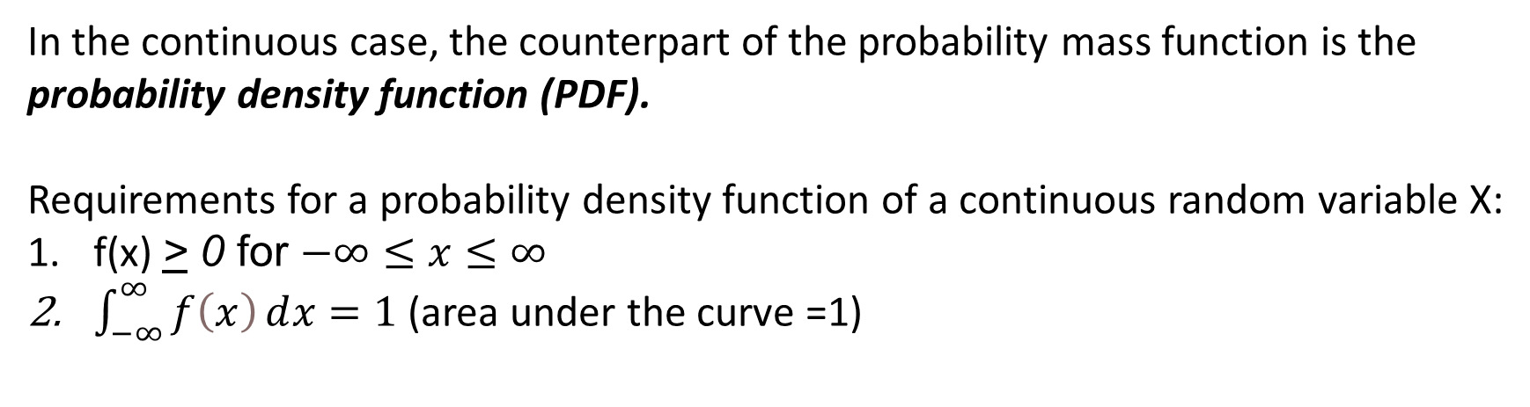
Suppose a random variable X may take all values over an interval of real numbers. Then the probability that X is in the set of outcomes A, P(A), is defined to be the area above A and under a curve. The curve, which represents a function p(x), must satisfy the following:
1: The curve has no negative values (p(x) > 0 for all x)
2: The total area under the curve is equal to 1.
In the continuous case, the counterpart of the probability mass function is the probability density function (PDF).
Requirements for a probability density function of a continuous random variable X:
f(x) > 0 for $−∞≤x≤∞$
$\int_{−∞}^{∞}{f\left(x\right)ⅆx}=1$ (area under the curve =1)

Slide 28
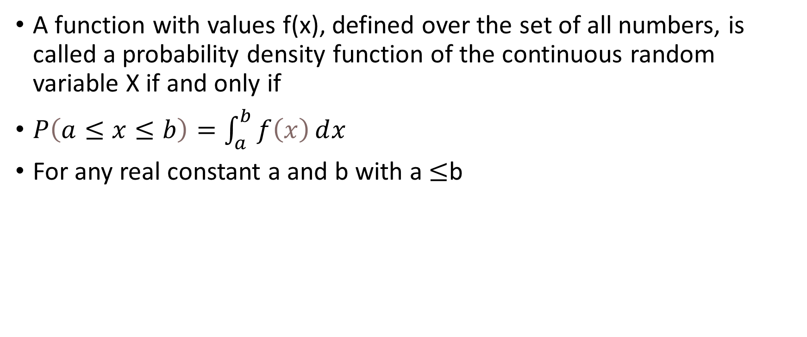
A function with values f(x), defined over the set of all numbers, is called a probability density function of the continuous random variable X if and only if
$P\left(a≤x≤b\right)=\int_{a}^{b}{f\left(x\right)ⅆx}$
For any real constant a and b with a $≤$b

Slide 29
All random variables (discrete and continuous) have a cumulative distribution function (CDF). It is a function giving the probability that the random variable X is less than or equal to x, for every value x.
outcome | 1 | 2 | 3 | 4
probability | 0.1 | 0.3 | 0.4 | 0.2
The cumulative distribution function for the above probability distribution is calculated as follows:
The probability that X is less than or equal to 1 is 0.1, the probability that X is less than or equal to 2 is 0.1+0.3 = 0.4, the probability that X is less than or equal to 3 is 0.1+0.3+0.4 = 0.8,

Slide 30
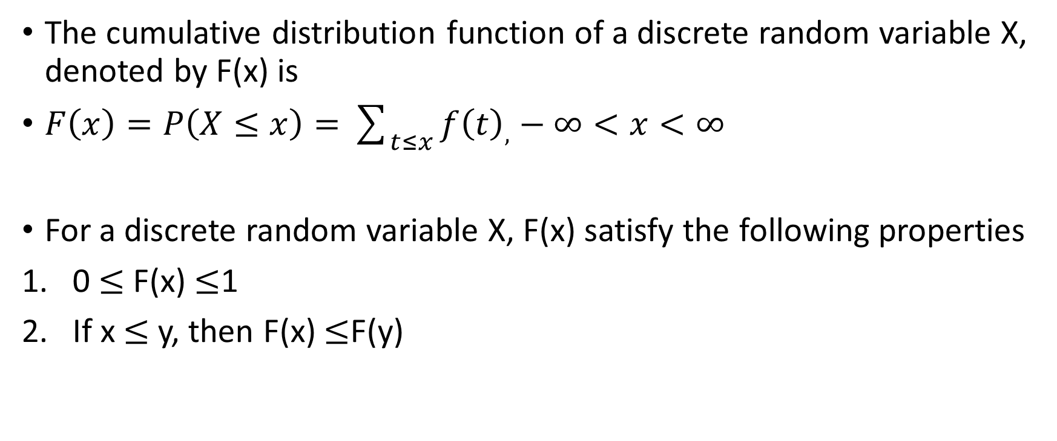
The cumulative distribution function of a discrete random variable X, denoted by F(x) is
$F\left(x\right)=P\left(X≤x\right)=\sum_{t≤x}{f{\left(t\right)}_{,}}−∞<x<∞$
For a discrete random variable X, F(x) satisfy the following properties
0 $≤$ F(x) $≤$1
If x $≤$ y, then F(x) $≤$F(y)

Slide 31
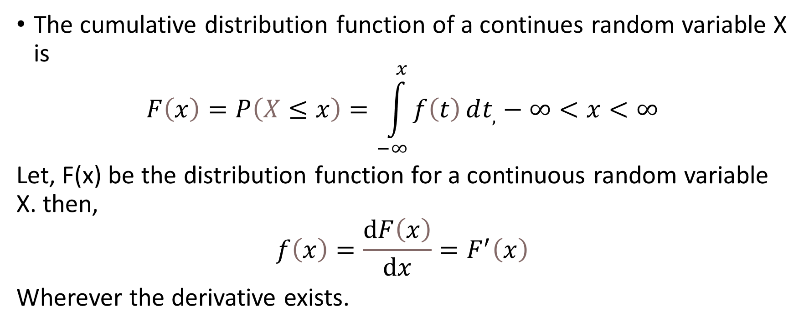
The cumulative distribution function of a continues random variable X is
$$F\left(x\right)=P\left(X≤x\right)=\int_{−∞}^{x}{f\left(t\right)ⅆt_{,}}−∞<x<∞$$
Let, F(x) be the distribution function for a continuous random variable X. then,
$$f\left(x\right)=\frac{ⅆF\left(x\right)}{ⅆx}=F^{′}\left(x\right)$$
Wherever the derivative exists.

Slide 32
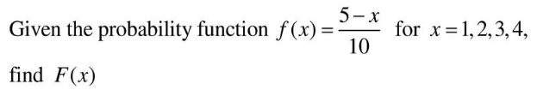
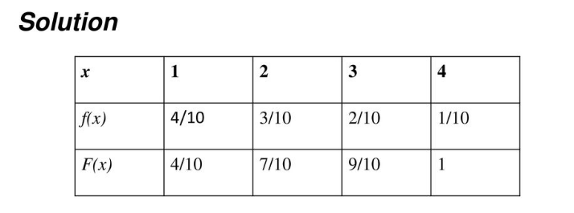

Slide 33
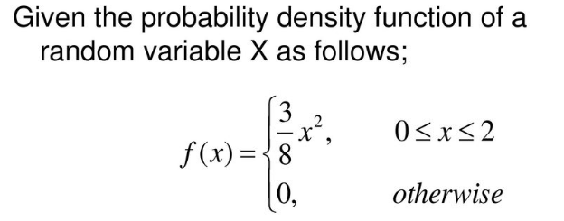


Slide 34
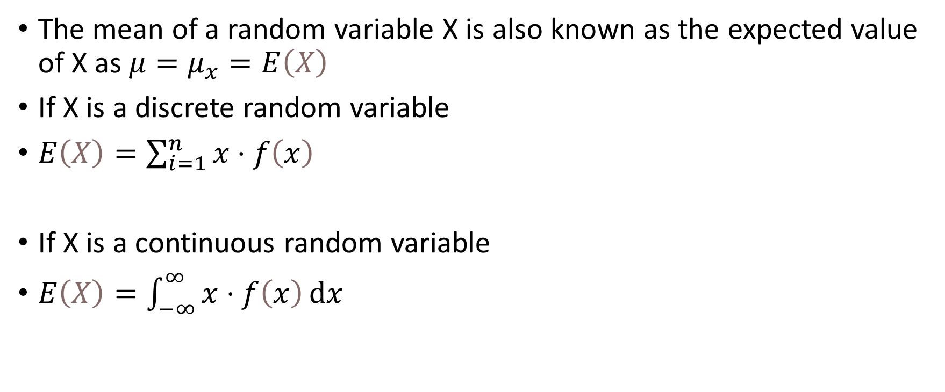
Expected Value
The mean of a random variable X is also known as the expected value of X as $μ=μ_{x}=E\left(X\right)$
If X is a discrete random variable
$E\left(X\right)=\sum_{i=1}^{n}{x}⋅f\left(x\right)$
If X is a continuous random variable
$E\left(X\right)=\int_{−∞}^{∞}{x⋅f\left(x\right)ⅆx}$

Slide 35
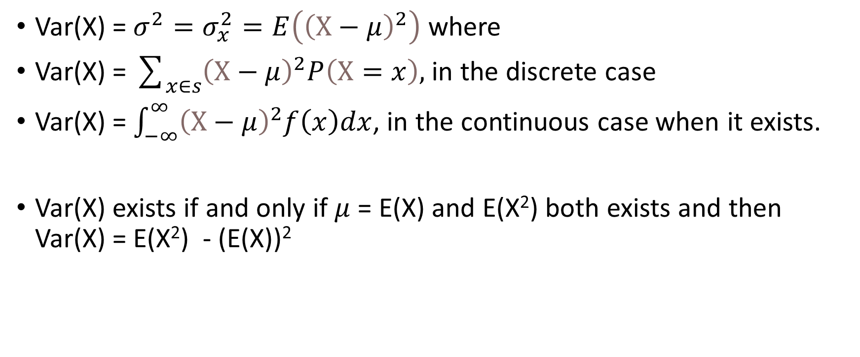
Variance
Var(X) = $σ^{2}=σ_{x}^{2}=E\left({\left(X−μ\right)}^{2}\right)$ where
Var(X) = $\sum_{x∈s}{{\left(X−μ\right)}^{2}P\left(X=x\right), }$in the discrete case
Var(X) = $\int_{−∞}^{∞}{{\left(X−μ\right)}^{2}f\left(x\right)dx}$, in the continuous case when it exists.
Var(X) exists if and only if $μ$ = E(X) and E(X²) both exists and then Var(X) = E(X²) - (E(X))²

Slide 36
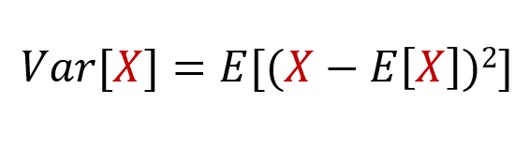
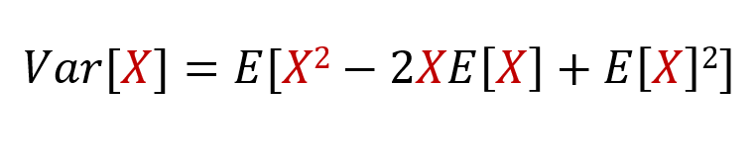

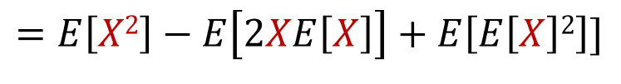
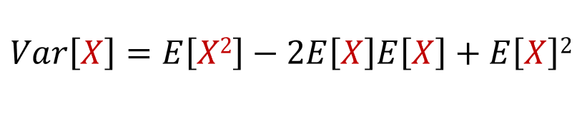
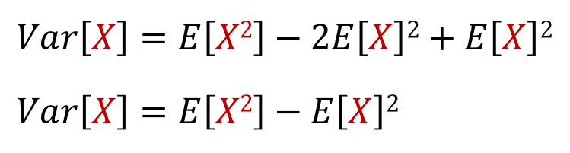

Slide 37
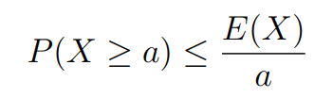
Markov’s Inequality
Let X be a random variable that takes only non-negative values. Then for any positive real number a

Slide 38
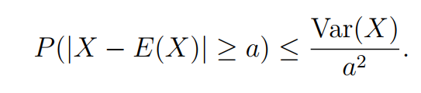
Chebyshev’s Inequality
Let X be any random variable with finite expected value and variance. Then for every positive real number a,

Slide 39

Proof
$P\left(\left|X−E\left(X\right)\right|≥a\right)=P\left( {\left(\left|X−E\left(X\right)\right|\right)}^{2}≥a2\right))$
$≤ \frac{E ({\left(\left|X−E\left(X\right)\right|\right)}^{2})}{a2}$ [Markov’s Inequality ]
$$≤\frac{Var(X)}{a2}$$

Slide 40

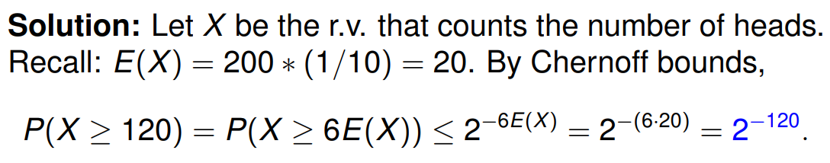
Chernoff Bounds
Suppose we conduct a sequence of n mutually independent trials
A biased coin is flipped 200 times consecutively, and comes up heads with probability 1/10 each time it is flipped. Give an upper bound on the probability that it will come up heads at least 120 times.

Slide 41
References
https://www.cliffsnotes.com/study-guides/statistics/sampling/populations-samples-parameters-and-statistics
https://stattrek.com/sampling/populations-and-samples.aspx
https://www.mathsisfun.com/data/standard-deviation.html
http://www.stat.yale.edu/Courses/1997-98/101/ranvar.htm
https://www.mathsisfun.com/data/random-variables.html
Probability & Statistics for Engineers & Scientists by Ronald E. Walpole, Raymond H. Myers, Sharon L. Myers, Keying Ye
PROBABILITY AND STATISTICAL INFERENCE by Robert V. Hogg, Elliot A. Tanis, Dale L. Zimmerman

